Slide 1
Metrics to evaluate classification models
How to know if a classification model works well?

Slide 2

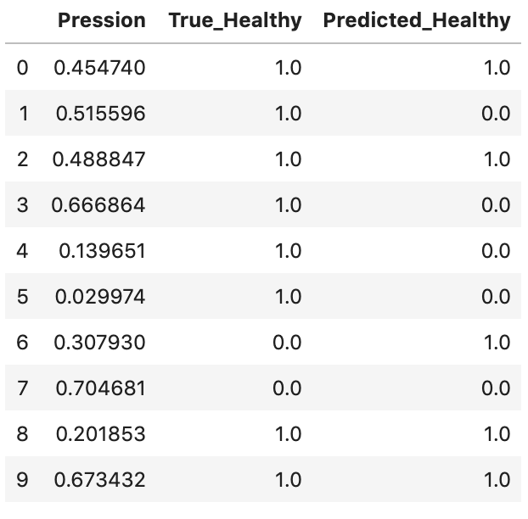
The doctor
You are a doctor. We have tons of data about Pression value of each value and the information “is sick or healthy”.
We train a classifier on the Training set and evaluate performances on the Test set.

Slide 3
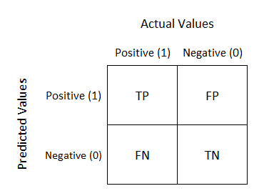
Confusion Matrix
Confusion Matrix
True Positive (TP)
False Negative (FN)
False Positive (FP)
True negative (TP)
1 = Positive = Sick
0 = Negative = Healthy

Slide 4
Accuracy
Recall (of sick detection)
Imagine to have 100 patients. We predict if a patient is sick or not (Sick and Healthy) and we observe that we did a correct prediction on 80 patients.
The accuracy is 80/100 = 80%
100 patients
Total patients = 100
True Sick over 100 = 20
In the group of 20 sick, our classifier detected 10 true sick.
Recall is the ratio of the true sick detected over the total number of true sick. 10/20 = 50% because on the total 20 sick in dataset, we are able to detect only 10 (the half)
SICK (20)
HEALTHY (80)
10
40
Sick detected by my classifier (50)

Slide 5
Accuracy
Precision (of sick detection)
Imagine to have 100 patients. We predict if a patient is sick or not (Sick and Healthy) and we observe that when did a correct prediction on 80 patients.
The accuracy is 80/100 = 80%
100 patients
Total patients = 100
My classifier says that 50 are sick.
Precision is the % of real sick patients in the 50 detected by the classifier.
Imagine that in the 50 group, there are only 10 sicks, so precision is 10/50 = 20%
SICK (20)
HEALTHY (80)
10
40
Sick detected by my classifier (50)
Predicted by classifier

Slide 6
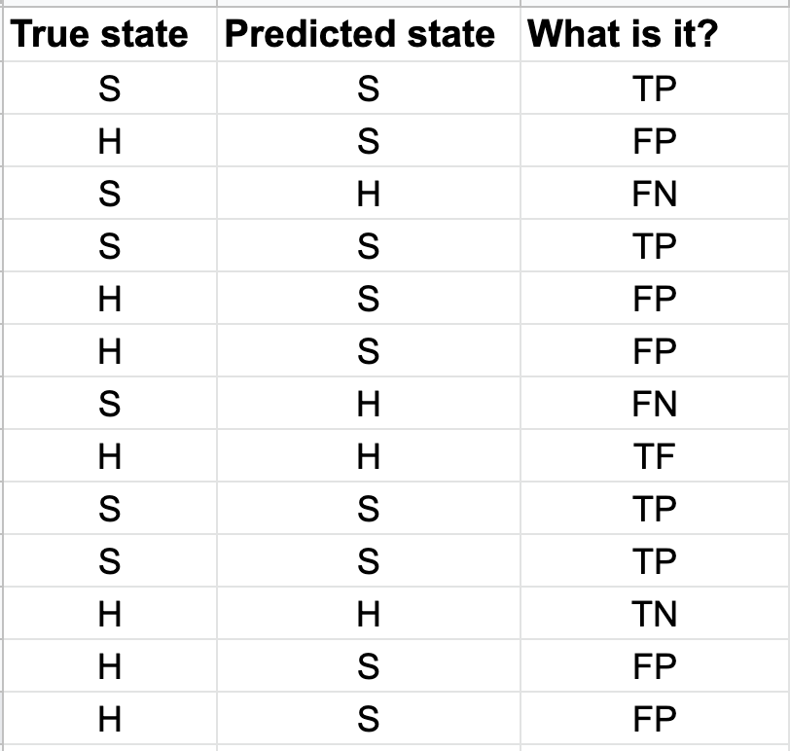
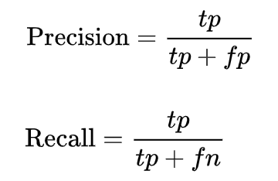
Formal Definitions
“Positive” is a choice: for use “positive” means sick.
The “positive” have to be chosen, we can decide.

Slide 7
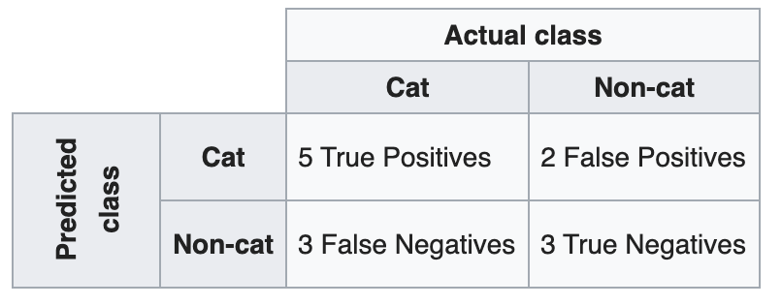
Confusion Matrix
It is a matrix used to inspect results in classification tasks. You can see in the matrix the correct predictions, False Positive and False Negatives.
Here is an example:
LINK to a good tutorial

Slide 8
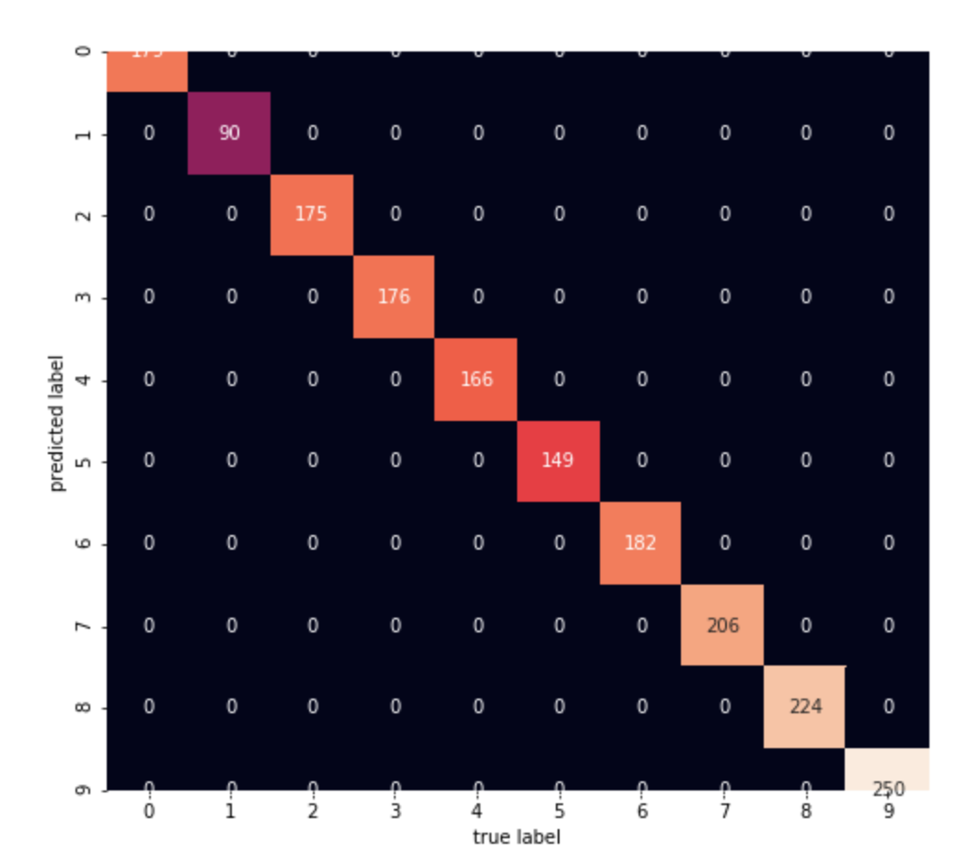
Confusion Matrix
It is a matrix used to inspect results in classification tasks. You can see in the matrix the correct predictions, False Positive and False Negatives.
Here is an example:
LINK to a good tutorial

Slide 9
ROC Curve
Get information!
LINK to a good tutorial

